Slide 1



Slide 2

“Brain Tumor Classification”
Supervised by:
Mr. Qasim Khan
Co. Supervisor:
Mr. Umair Khan
Group Members:
Fatiha Ilyas(SP17-BCS-009)
Khizra Mughal(SP17-BCS-014)
Department of Computer Science
COMSATS University Islamabad, Attock Campus

Slide 3
Outline
_______________________________
Introduction
Related Work
Objectives
Benefits
Requirement Specification
Methodology
Project Design
Implementation
Modern tools
Benefits
Conclusion
Future Work
References
_______________________________

Slide 4
Introduction
Brain tumor is caused by abnormal cells in brain. There are 120 types of brain tumor exist and each tumor type has different size and location.
Doctors interpret the MRI of patient and decide whether patient has Meningioma tumor , Glioma tumor or Pituitary tumor.
CAD systems contribute to physician’s in decision making processes that are needed and to minimize the chance of errors.
We are intended to make more efficient and accurate CAD that can improve the existing tumor classification methods.

Slide 5
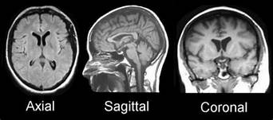
Cont..
CT-Scan images provide insufficient information unlike MRI image.
Modalities are angles of MRI captures.
Angles inside the brain such as Axial, Sagittal and Coronal.

Slide 6
Related Work
Machine learning ensures the decision-making process for the analysis. it consists of following approaches:
1.Deep Neural Network Classifier (DNN):
Working:
Classified four types of tumor classes.
Walvet transformation and feature extraction tool used in model.
Achieved 96% accuracy for the whole dataset.
High computation time & Low accuracy.

Slide 7
Cont..
2.Artificial Neural Network classifier (ANN):
Working:
Used astrocytoma tumor type for classification.
Performed pre-processing method such as histogram, segmentation and morphological technique .
Gray Level Co-occurrence Matrix (GLCM) method for feature extraction.
Neuro Fuzzy method was developed for classification.
High computational time.
Physical memory consumption.

Slide 8
Cont..
3. Support Vector Machine (SVM) classifier:
Working:
Used 50 patient’s brain images with two classes such as 'Normal’ and 'Abnormal’.
Performed feature extraction by applying grey scaling.
SVM classification algorithm they classified the tumor type successfully.
High computational time.
Physical memory consumption.

Slide 9
Cont..
4. K Nearest Neighbour Classifier (KNN): Working:
Used Normal, Benign and Malignant brain tumor images.
K-NN classification depends on:
Determination of k value.
Distance calculation between the query instance and the training samples.
Sortation of distance based on the kth minimum distance.
Assignment of majority class.
Determination of class.

Slide 10
Problem Statement
Brain tumors vary in shape, size, location, and the intensity. Physicians sometime fail to detect the early signs.
Therefore, it is very difficult to detect tumor and diagnose it through manual identification of tumor.
From MRI images, it is subjective in nature and may vary from their expertise and other factors which classify as it is tumor or not.
So, an automated identification of brain tumor from MRI images will be helpful for providing accurate and less time- consuming results.

Slide 11
Objectives
To build a system which will helpful for the radiologists and physicians to classify the brain tumor accurately and efficiently in MRI image.
Less chance than human error.
Flexible to large data amount.
Has accuracy, low complexity and performance.
Fast computational speed.
Cost effective.

Slide 12
Benefits
Our proposed application provides a platform by the help of which neurosurgeons can classify the tumor from the given MRI scan whether it is Meningioma, Glioma or Pituitary.
It saves the time of radiologists by making every step automatic in the process of classification.

Slide 13
Requirements Specifications (Functional Requirements)
Image acquisition
Preprocessing
Segmentation
Feature extraction
Classification
Result
13

Slide 14
Requirements Specifications (Non-Functional Requirements)
Performance.
Capacity.
Availability.
Reliability.
Maintainability.
Efficiency.
Flexibility.
Usability.
14

Slide 15
Methodology
For betterment of our system we adopted to implement iterative methodology. This model has helped us to make modules that are isolated and easy to manage, making development much easier. Cycles are divided into smaller modules, which are easier to manage.

Slide 16
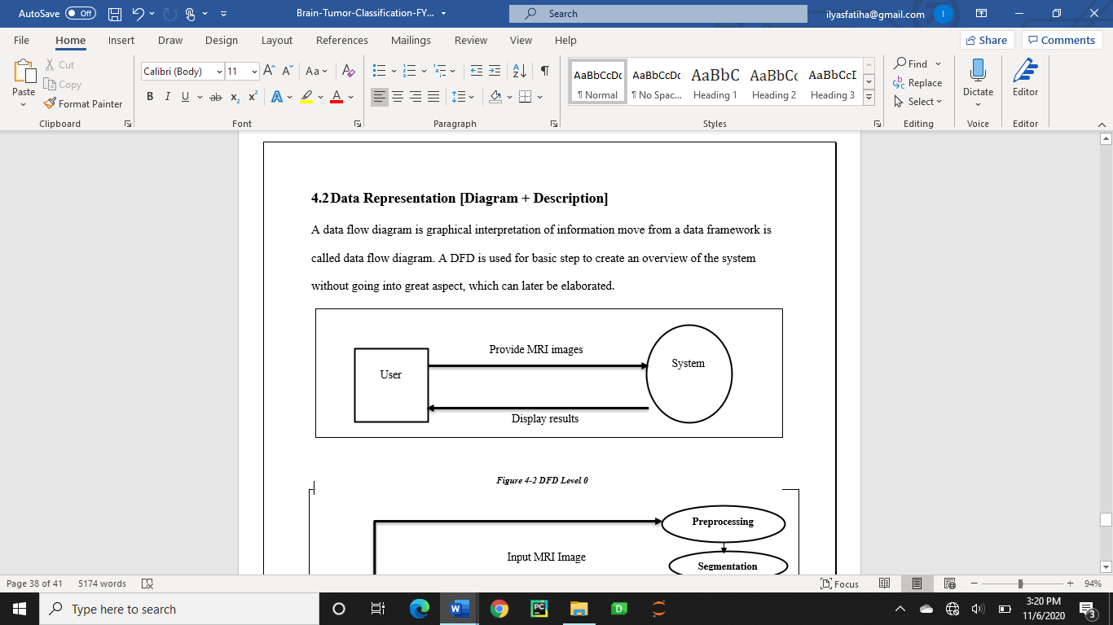
Project Design (Data Flow Diagram Level 0)

Slide 17
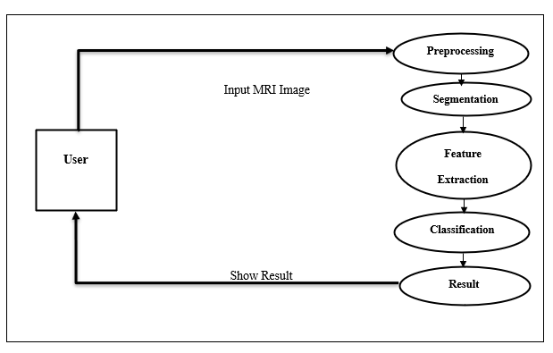
Project Design (Data Flow Diagram Level 1)

Slide 18
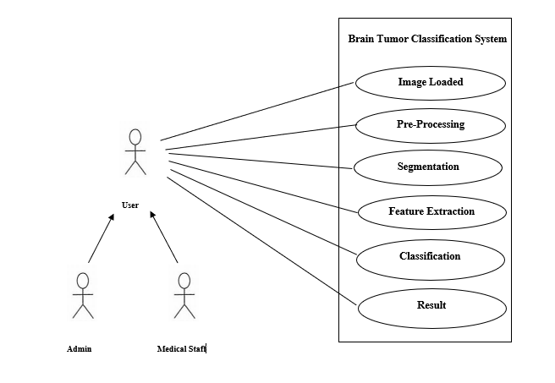
Project Design (Use Case Diagram)

Slide 19
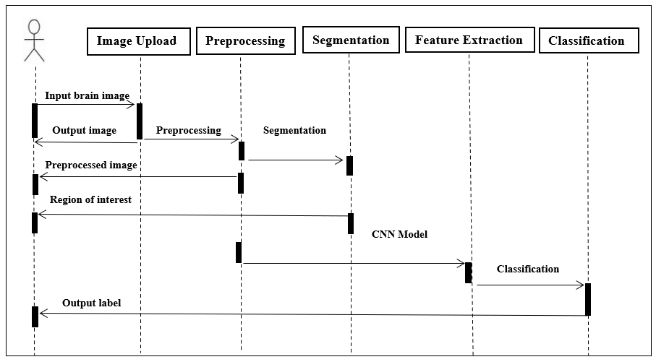
Project Design (Sequence Diagram)

Slide 20
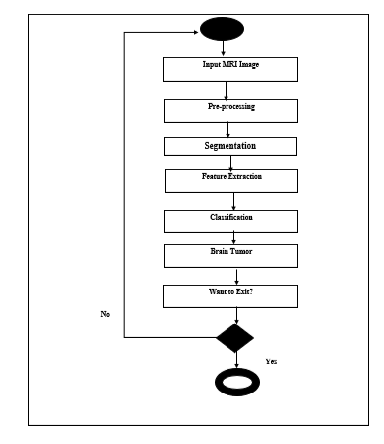
Project Design (Activity Diagram)

Slide 21
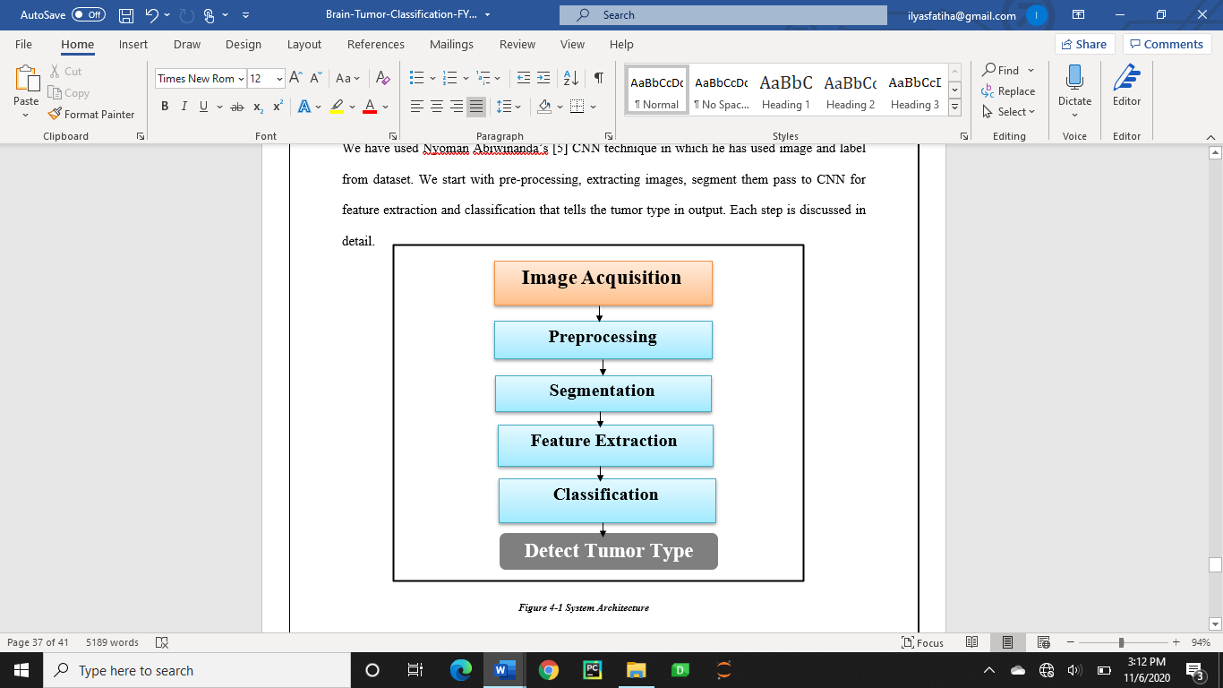
Implementation

Slide 22

User Interface (Splash Screen)

Slide 23
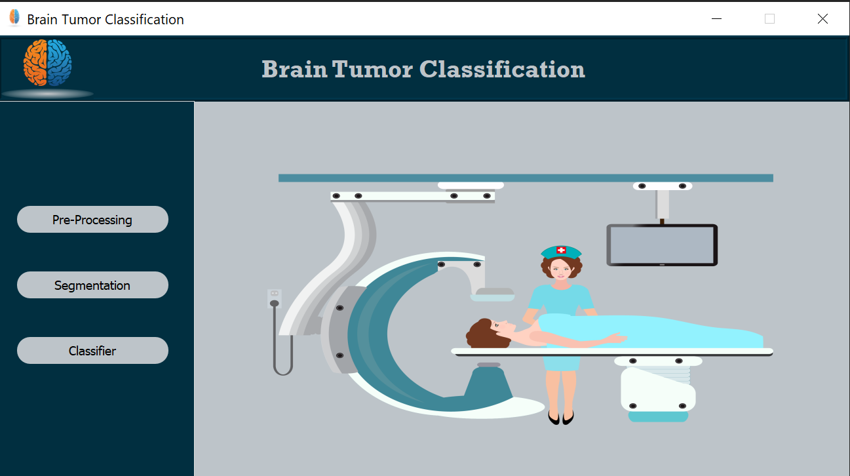
User Interface (Main Window)

Slide 24
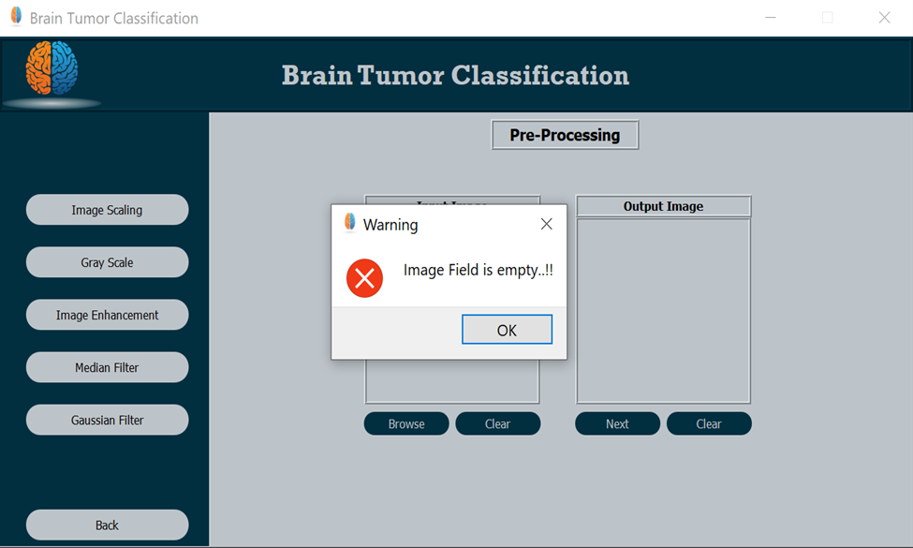
User Interface (Preprocessing)

Slide 25
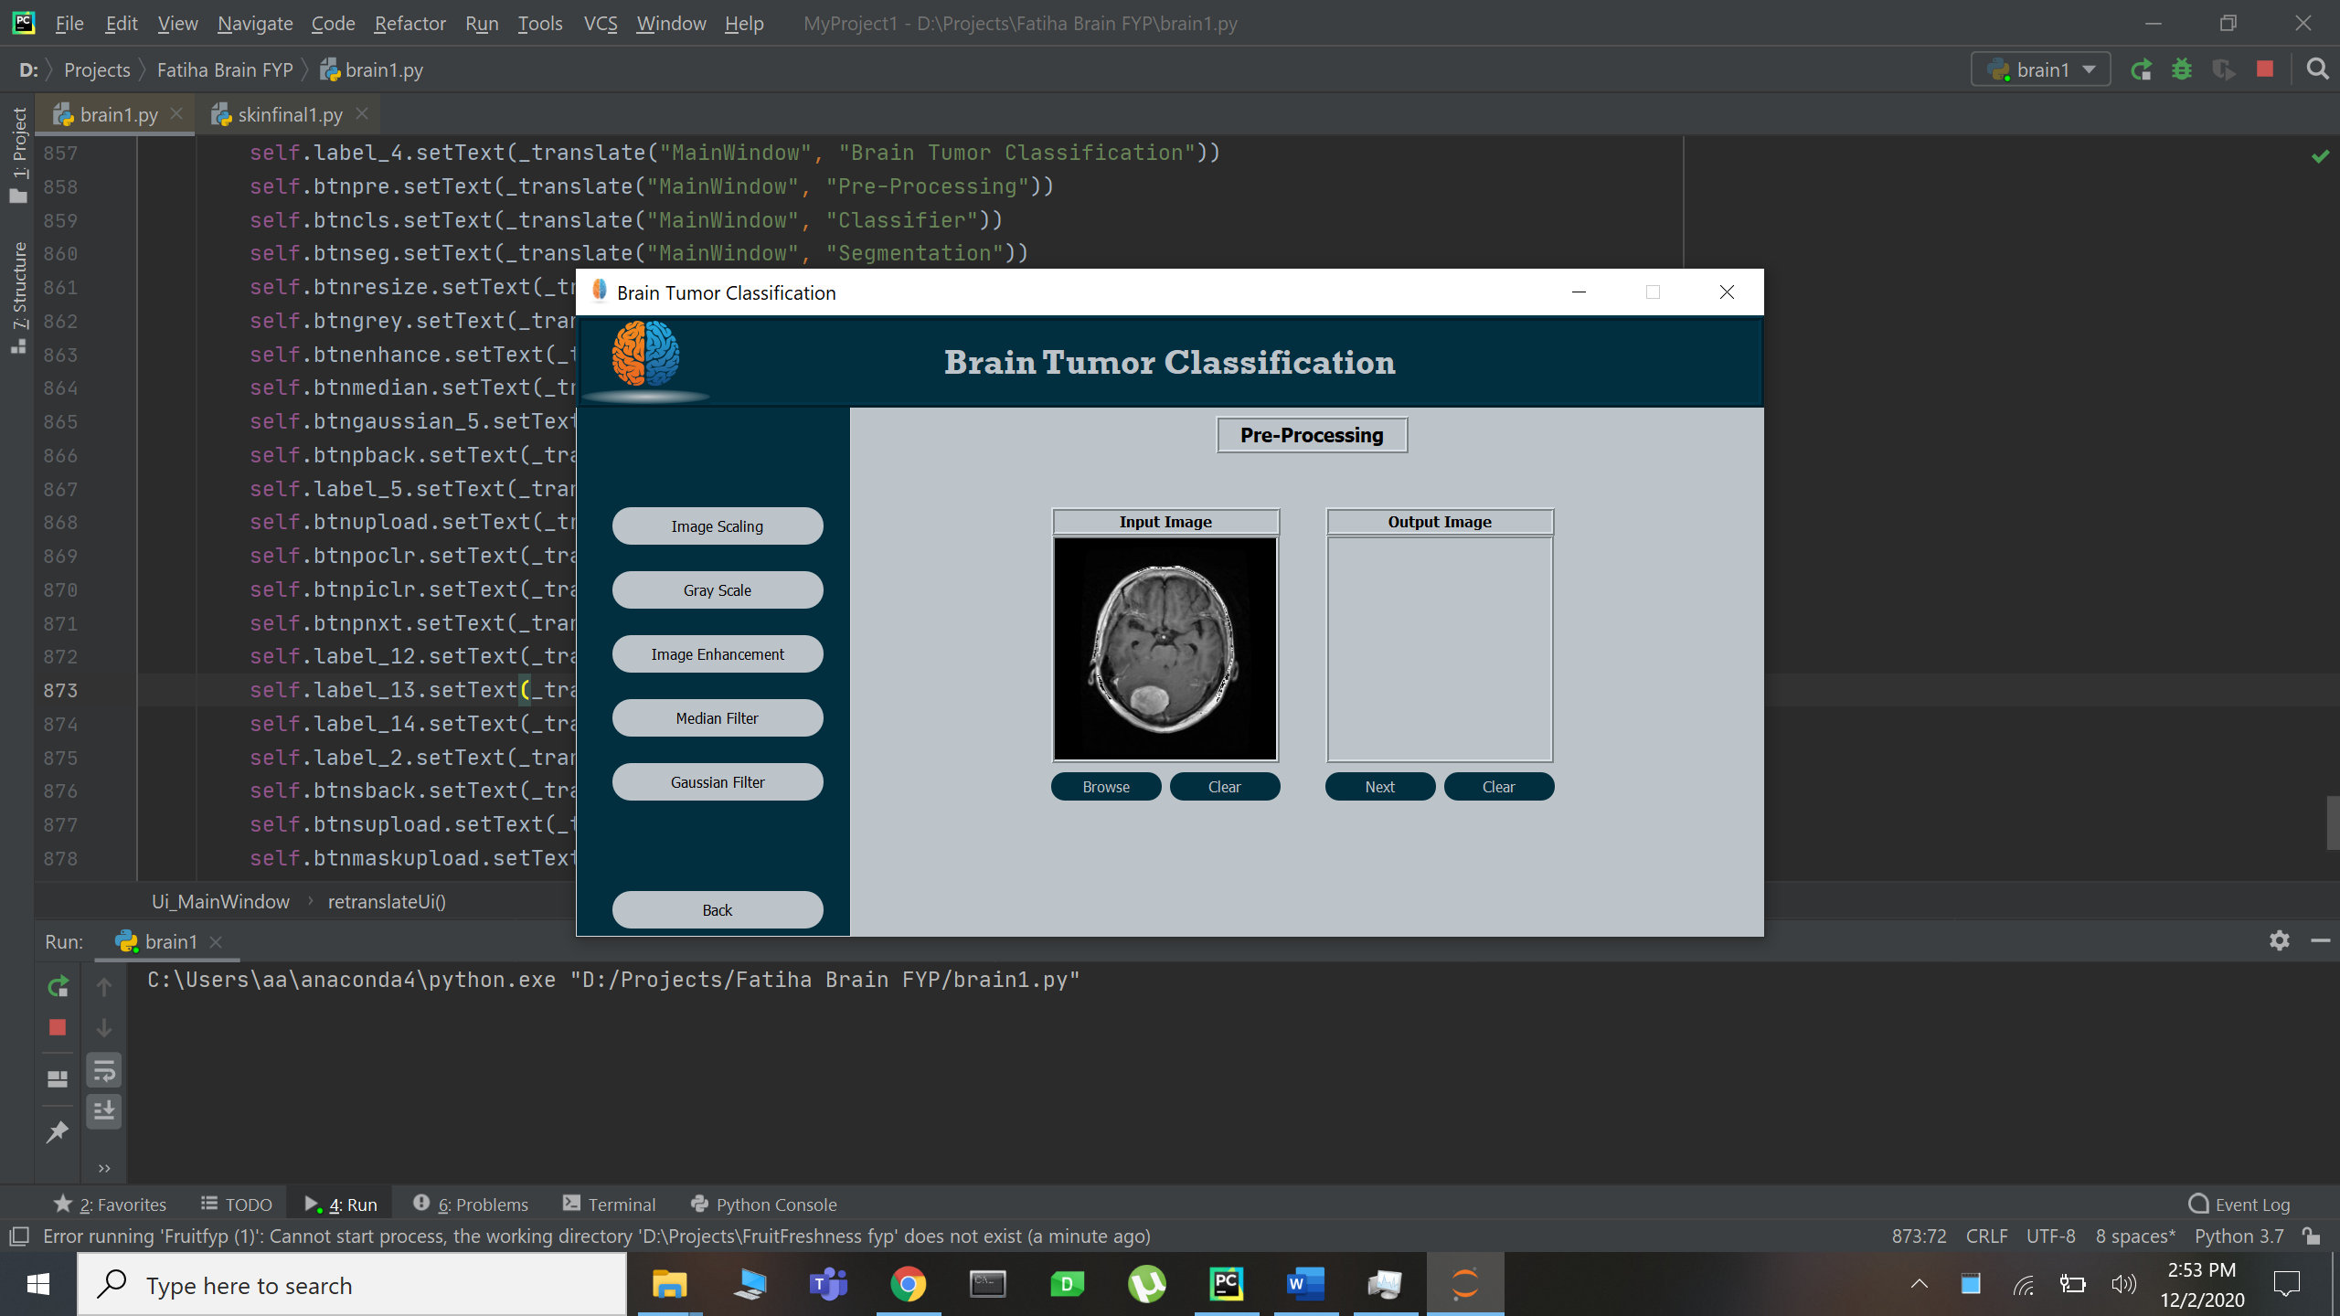
User Interface (Preprocessing)

Slide 26
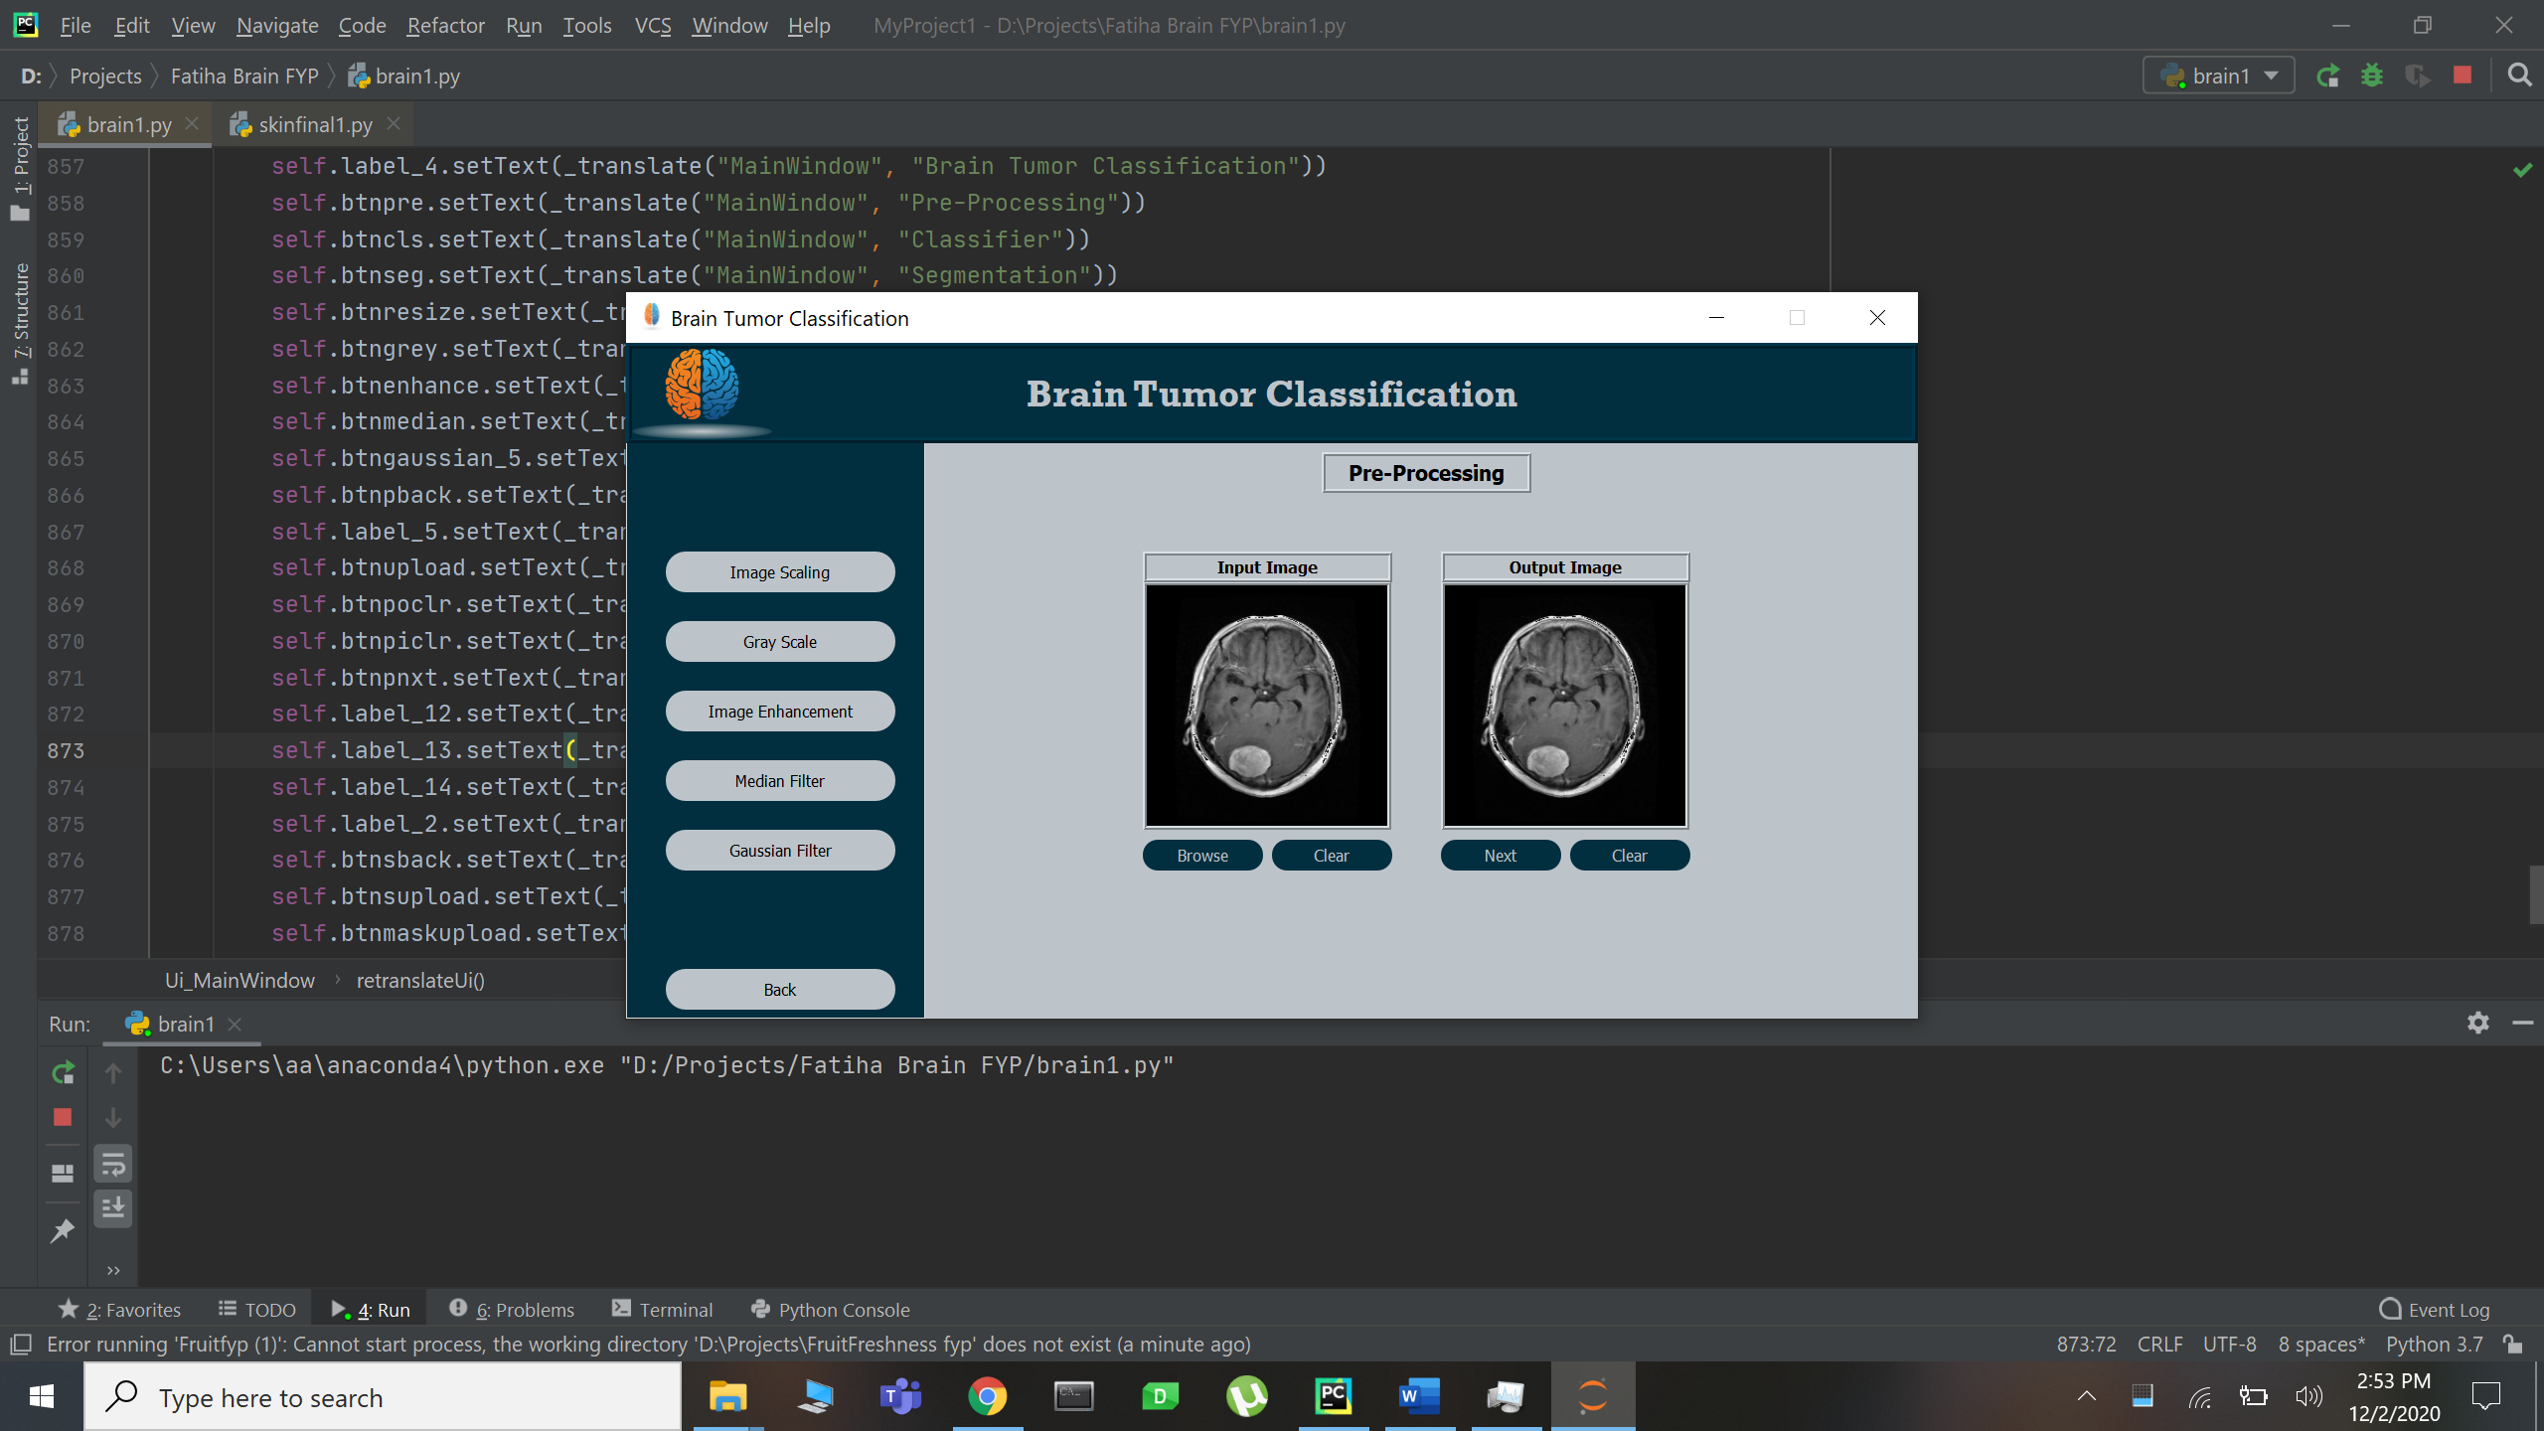
User Interface (Preprocessing)

Slide 27
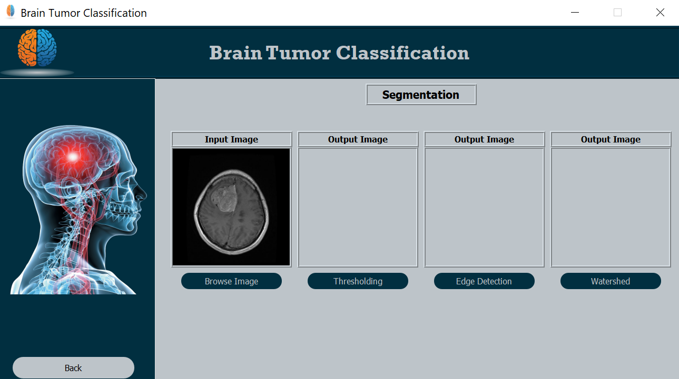
User Interface (Segmentation)

Slide 28
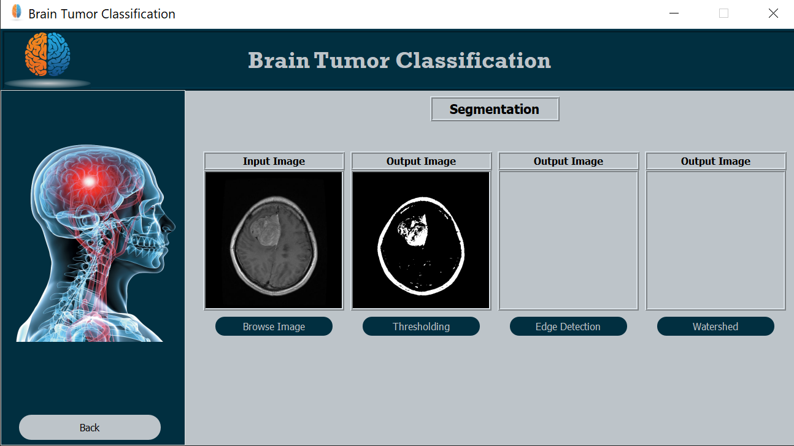
User Interface (Segmentation)

Slide 29
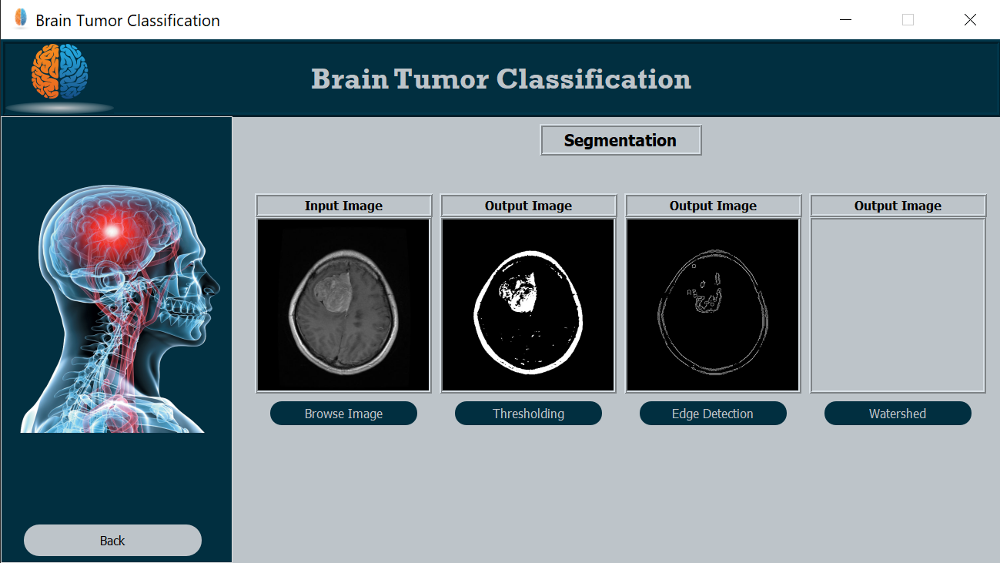
User Interface (Segmentation)

Slide 30
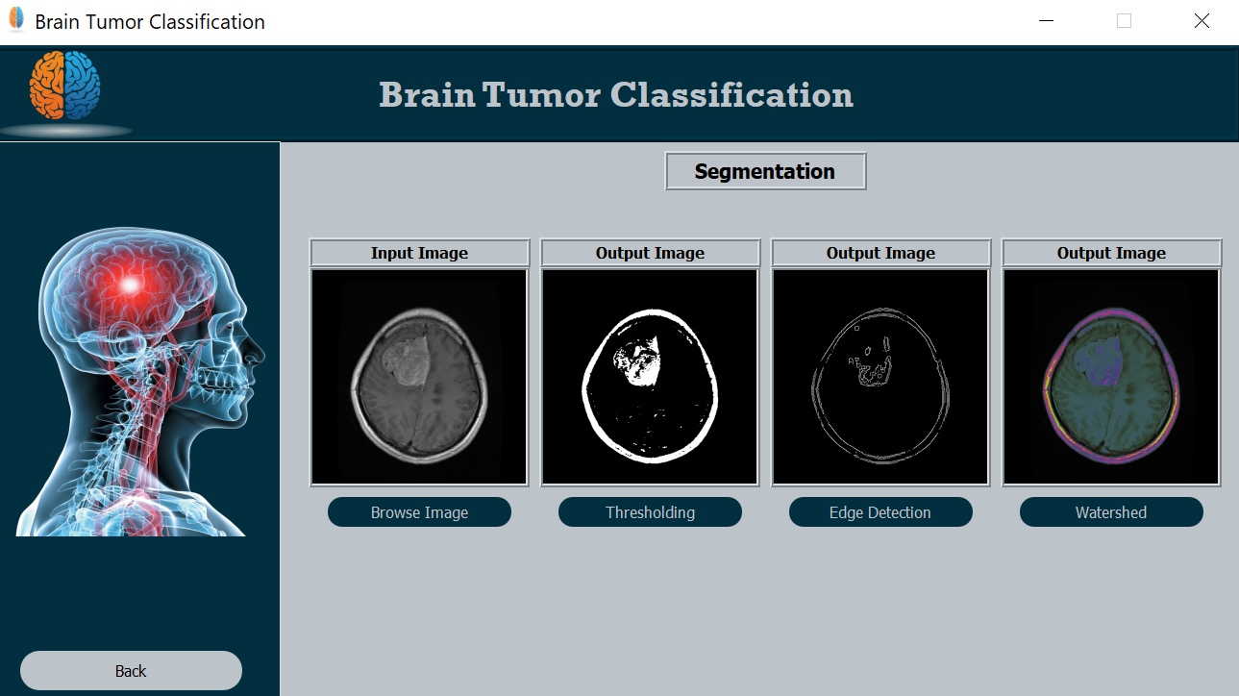
User Interface (Segmentation)

Slide 31
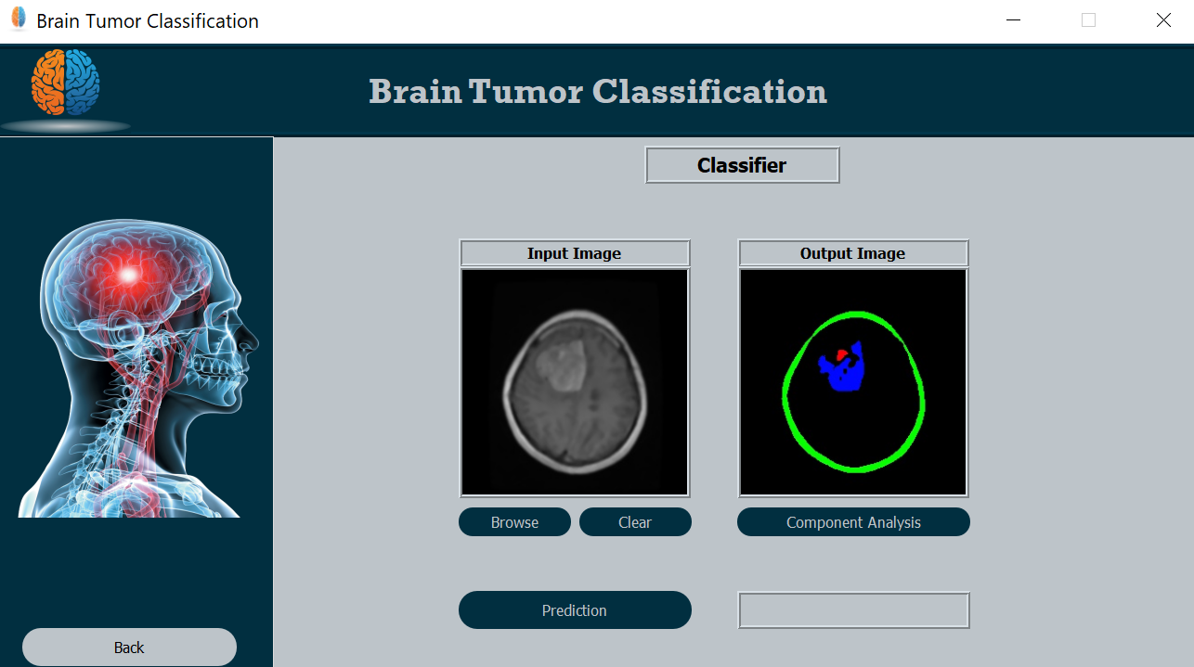
User Interface (Classification)

Slide 32
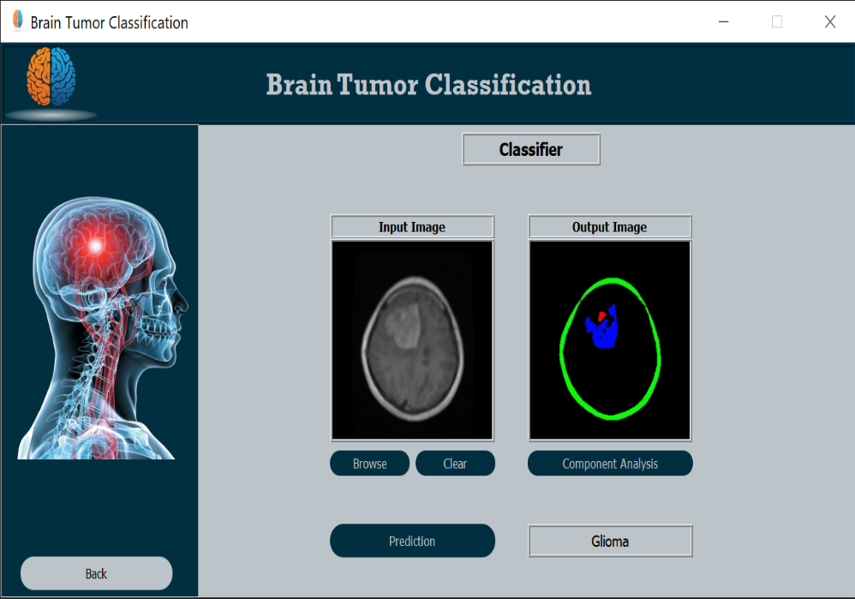
User Interface (Classification)

Slide 33
Modern Tools
Development Tool:
Python 3.7 IDE (32 bit).
JetBrains PyCharm community Edition 2019.
Anaconda distribution.
Window 10
MATLAB
Pyqt designer -Interface
MS Word -Documentation
MS PowerPoint- Presentation slides
Programming Language:
Python

Slide 34
Conclusion
Abnormal growth of tissue in the brain is considered a brain tumor.
Algorithms used in the proposed system are all meant to increase the efficiency of the system by achieving better results.
Convolution Neural Network generate the promising results.
Without prior segmentation, the CNN returns 100% accuracy of the network.

Slide 35
Future Work
There are multiple tumor types exist and need predictions. The number of tumor classes can also be increased if more data is available.
This automatic system can be implemented in clinics for doctors’ supportive tool to make decisions and treatments.

Slide 36
References
https://www.sciencedirect.com/science/article/pii/S2314728817300636#fig1
https://ieeexplore.ieee.org/abstract/document/5479975
https://ieeexplore.ieee.org/document/6804439
https://pdfs.semanticscholar.org/3889/dc9221de455f782a3b2b55a925454783969f.pdf.
Abiwinanda N., Hanif M., Hesaputra S.T., Handayani A., Mengko T.R. (2019) Brain Tumor Classification Using Convolutional Neural Network. In: Lhotska L., Sukupova L., Lacković I., Ibbott G. (eds) World Congress on Medical Physics and Biomedical Engineering 2018. IFMBE Proceedings, vol 68/1. Springer, Singapore.

Slide 37


